Slide 1
6) M.K. 35 yo
Periods very heavy and painful.
Increased urinary frequency.
Can feel a mass on her abdomen.
Never pregnant.
Myomectomy 10 years ago (laparotomy)
Known fibroids for at least 6 years.
US - uterus 535 cc. 2 large fibroids 10.4 x 9.5 x 7.5 and 8.1 x 9.0 x 9.2. Several small fibroids..

Slide 2
M.K. Summary
Large fibroids
Symptomatic
Recurrence
Never pregnant

Slide 3
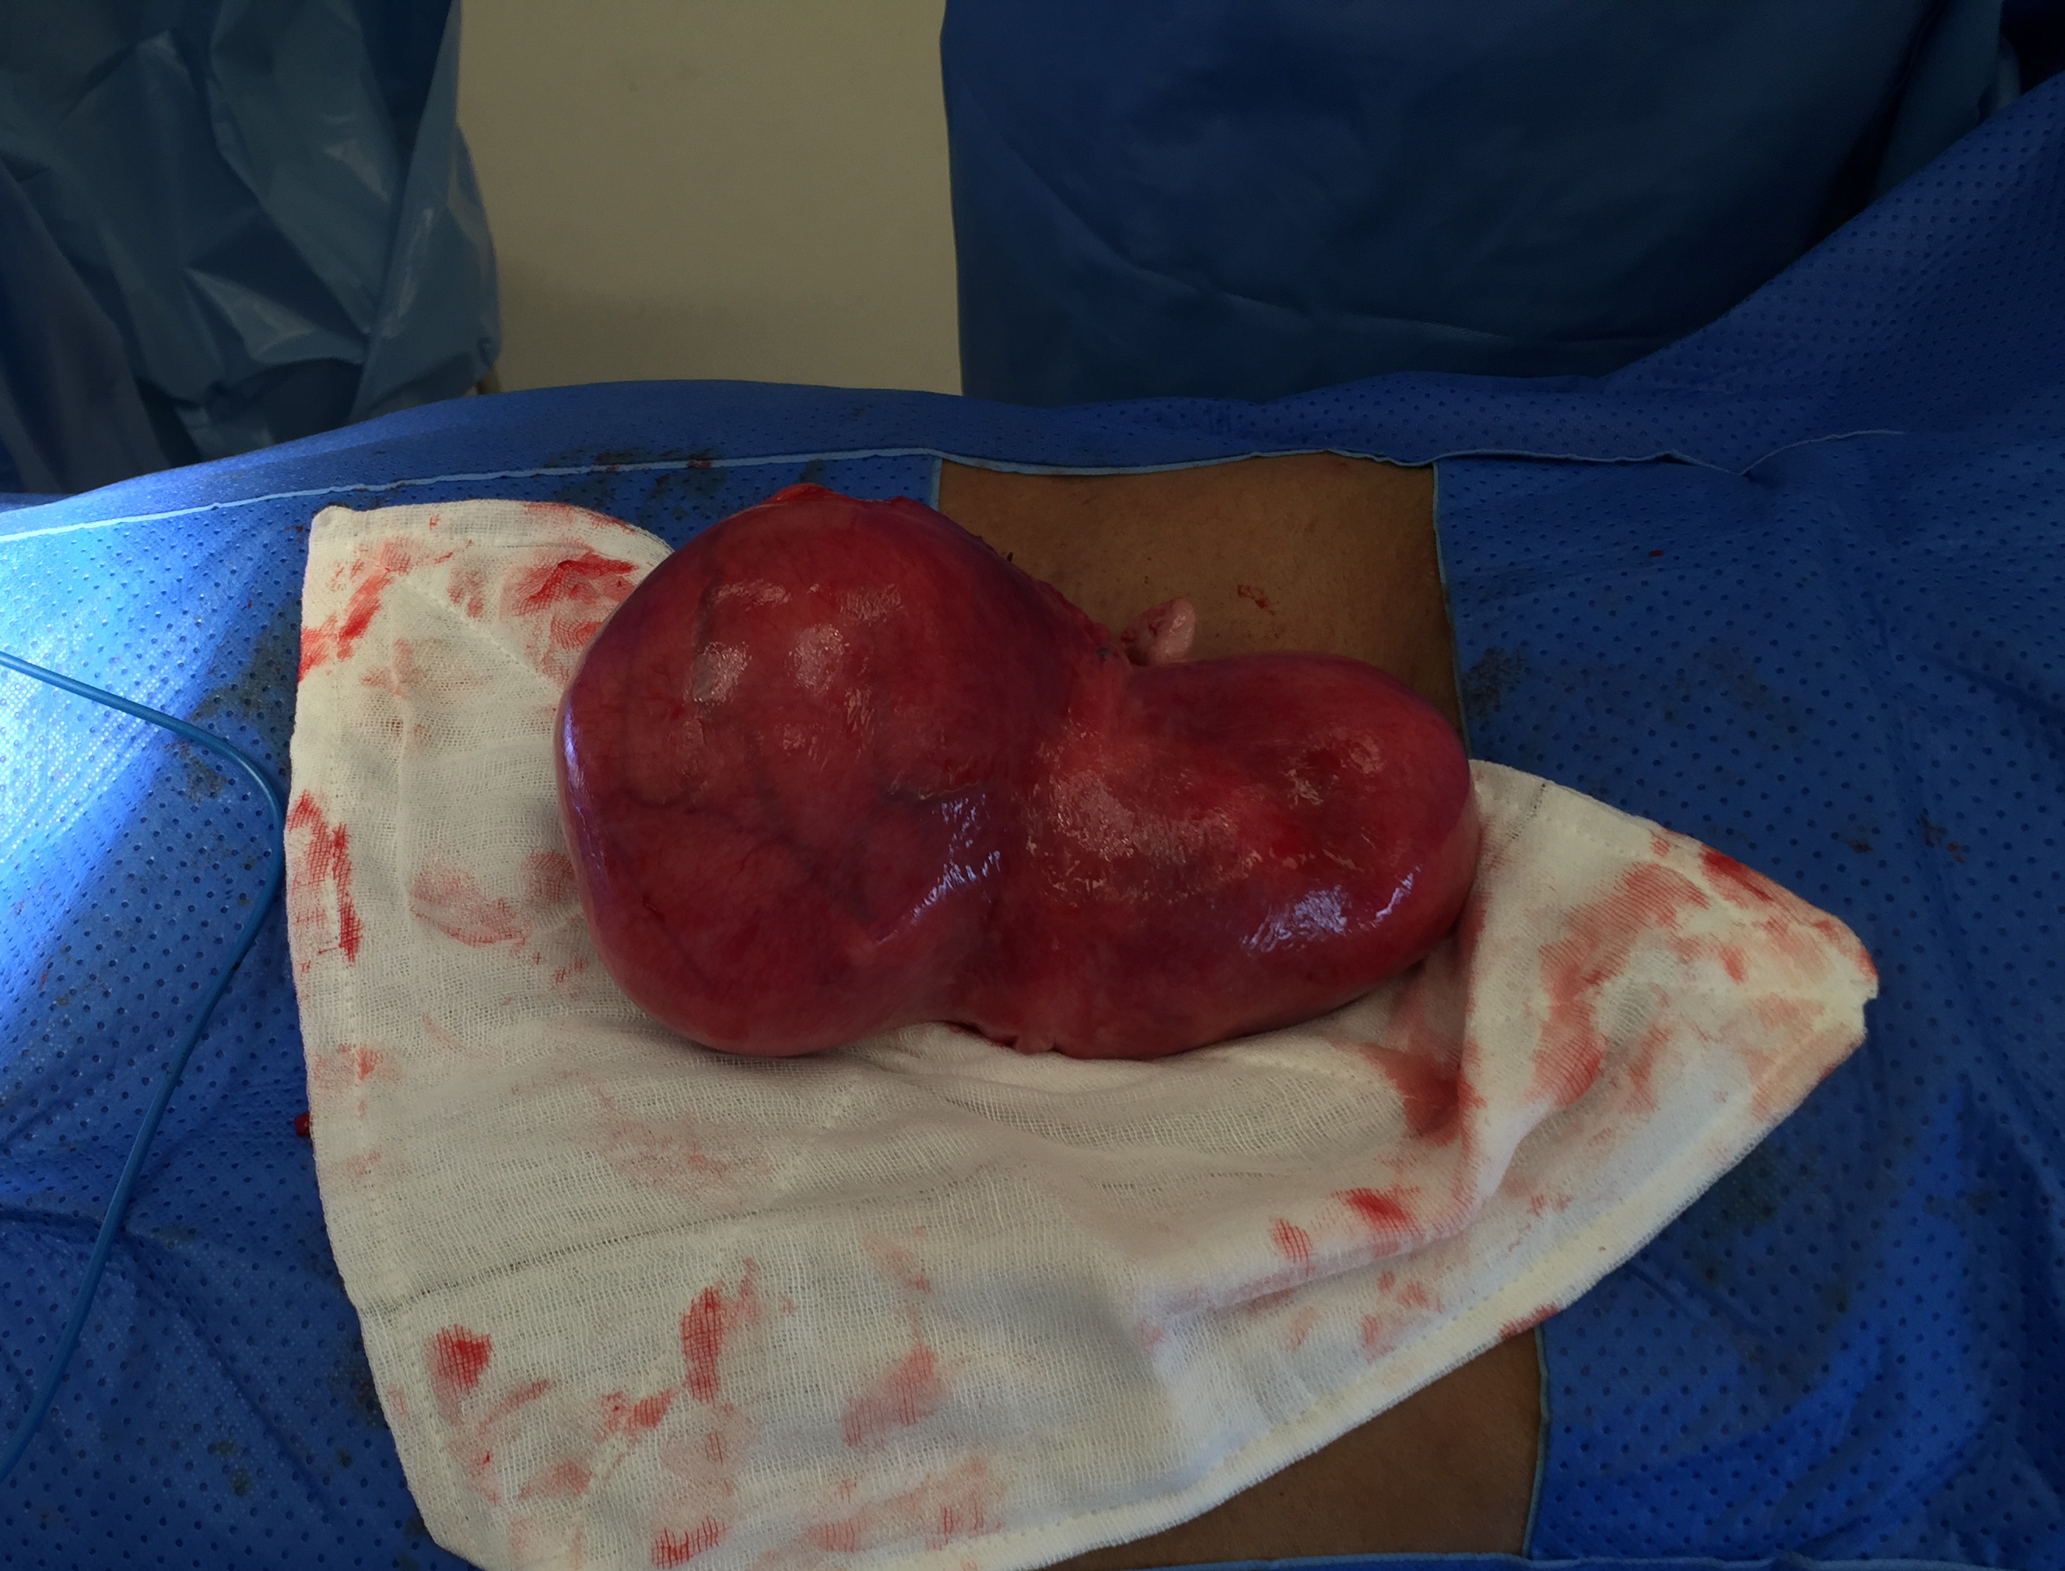
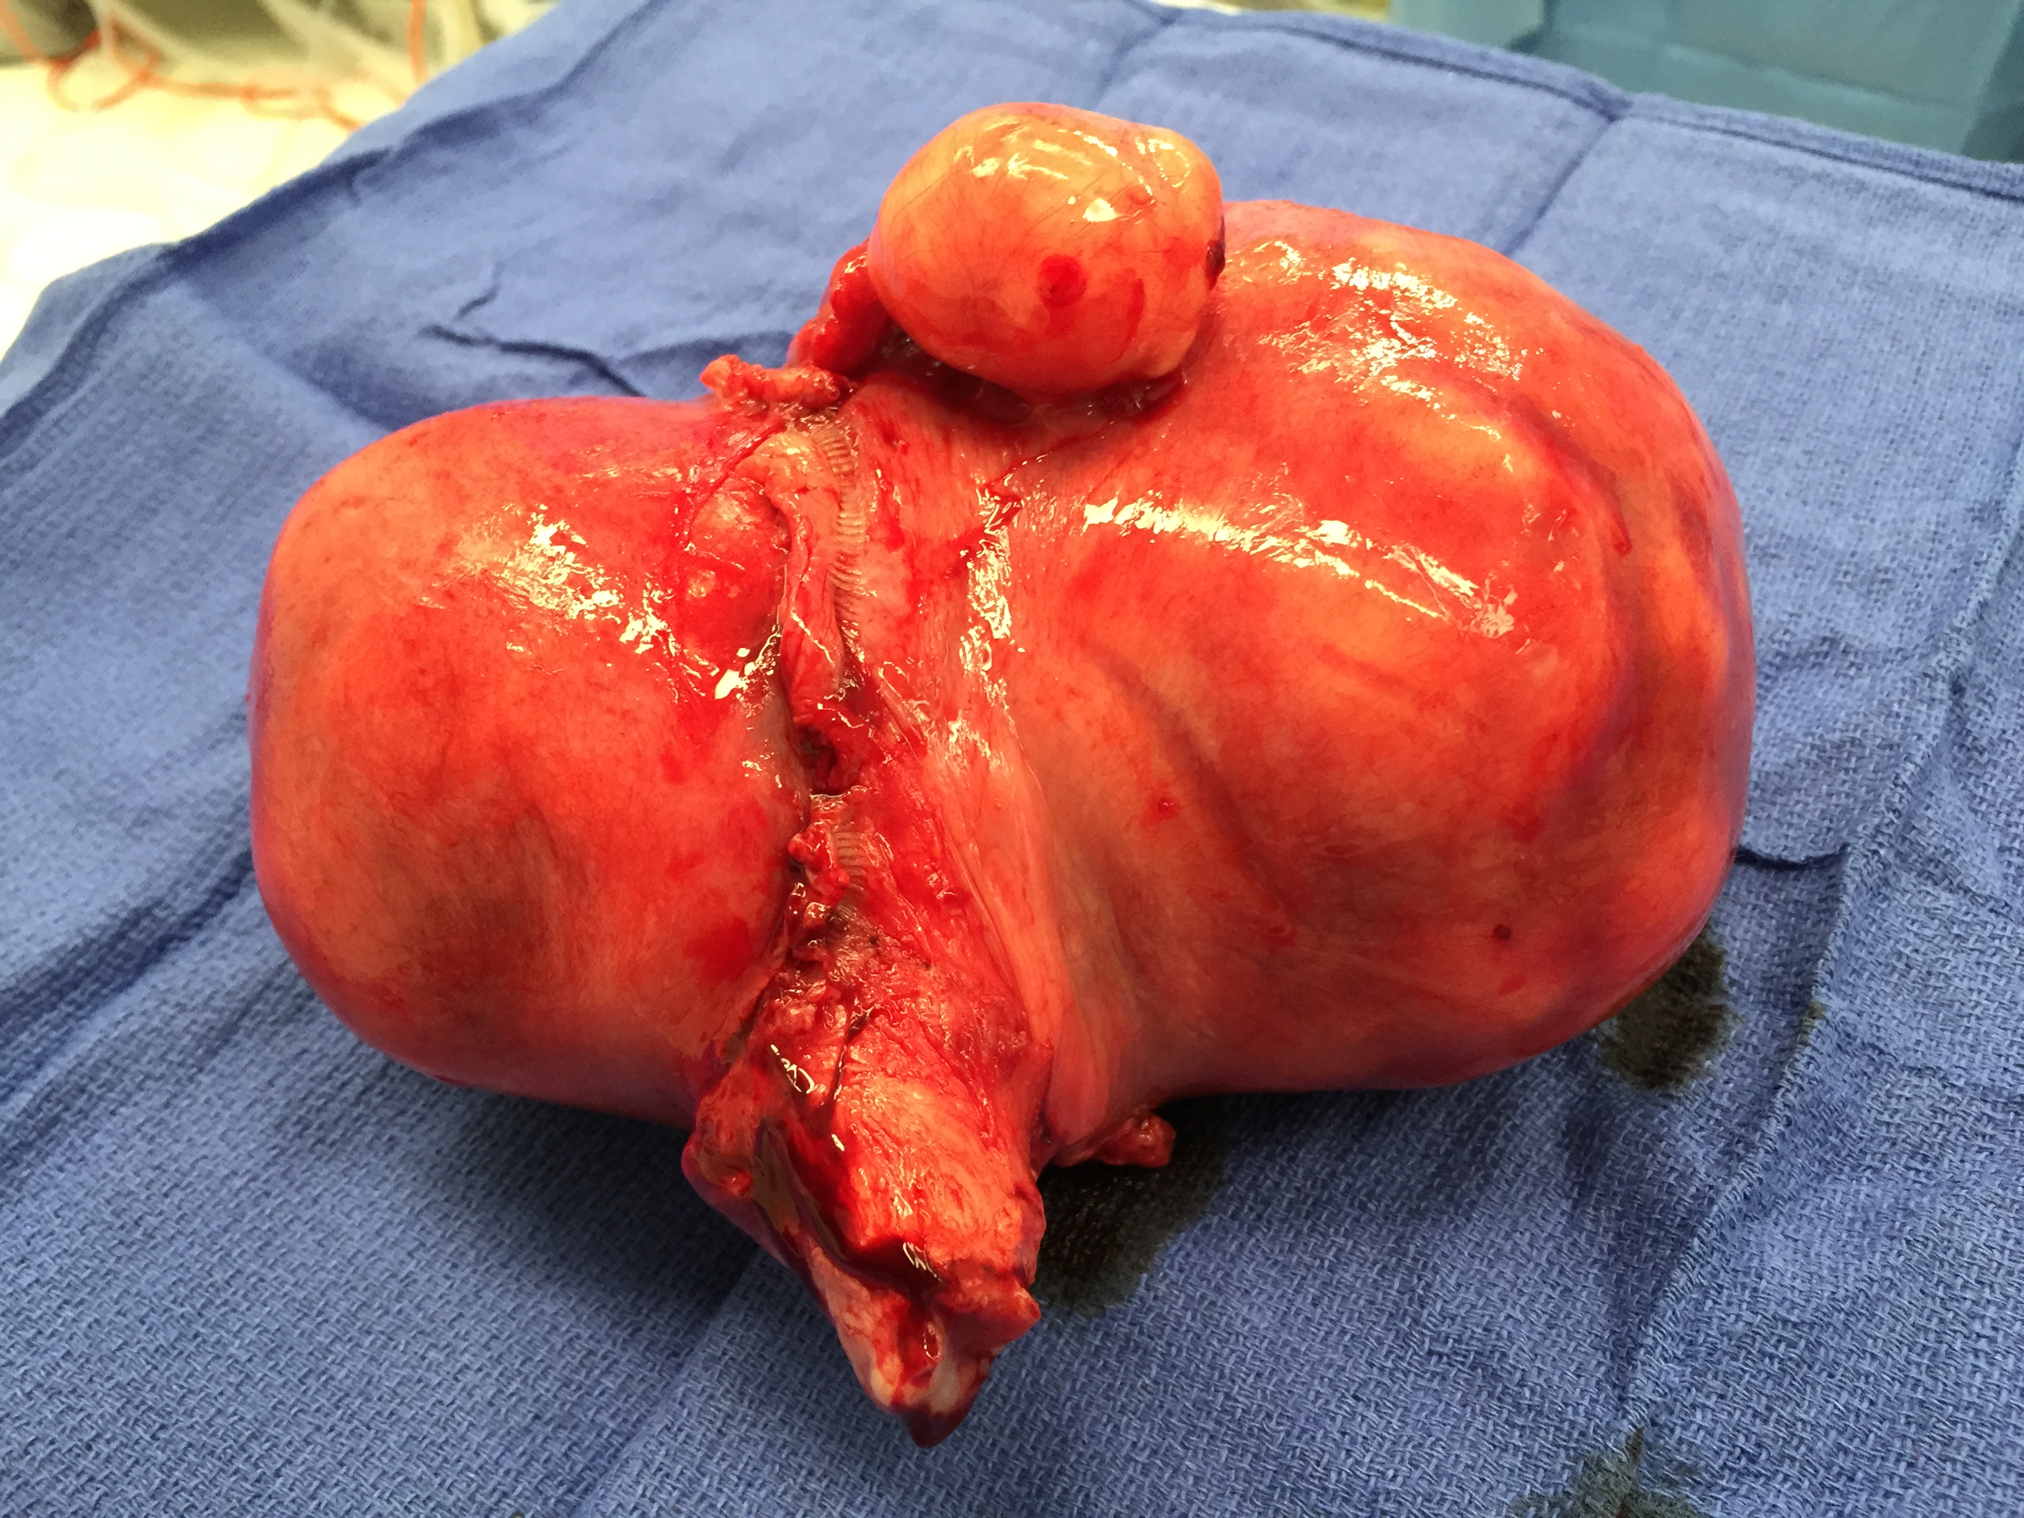
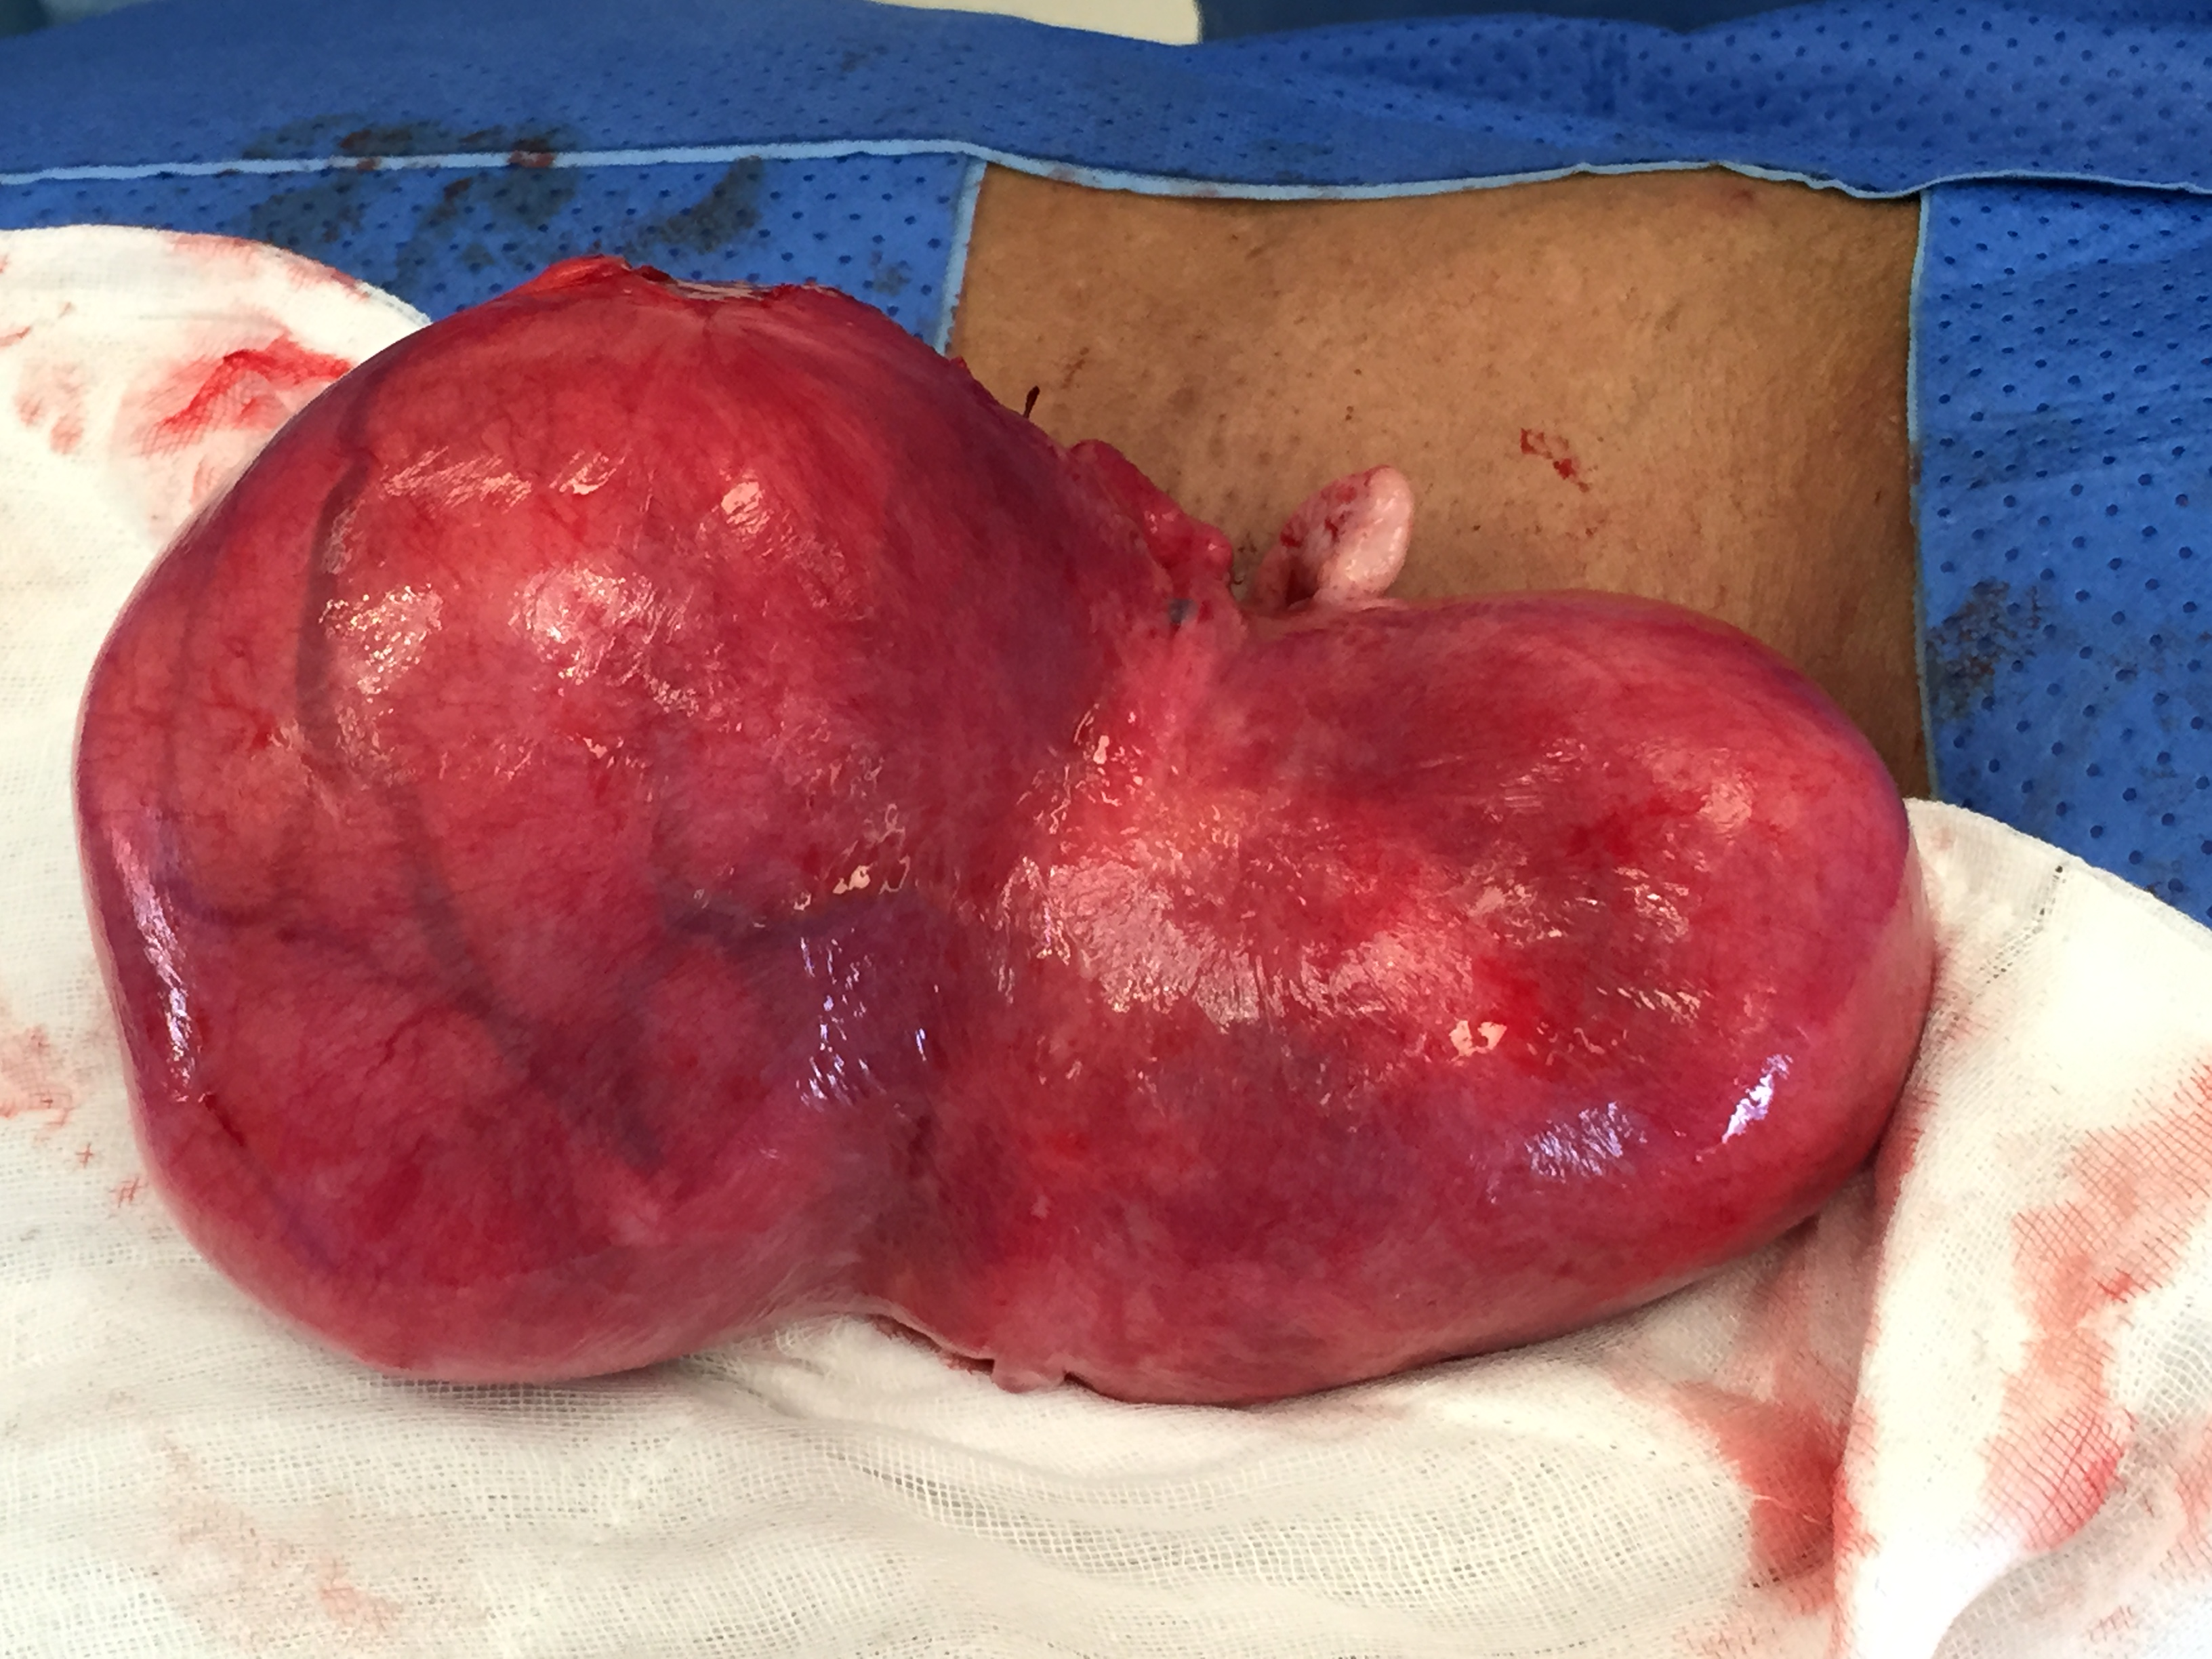

Slide 4
7) J.L . 30 yo
G1 P1. Dec -2012 – Normal delivery at 38 weeks.
30-05-12 (8 weeks gestation)
8 weeks size embryo. FHH +.
Note is made of a large fundal uterine fibroid 124 x 95 x 55 mm. Fibroid does not appear to compress the gestac. sac.
11-06-14
Fibroid: Size 161 x 154 x 98 mm. Volume 1272.2 ml. Type: intramural. Position: fundus. Extends to within 8 mm of the endometrium.
15-11-14
Large fibroid extending up to the abdomen. Approximate measurement 180 x 160 x 100 mm.
04-03-15
Fibroid: 186 x 181 x 99 mm, vol 1745ml. Type: Intramural fibroid.
Trying to fall pregnant unsuccessfully for about 12 months.

Slide 5
J.L. Summary
Very large fibroid
Trying to fall pregnant

Slide 6
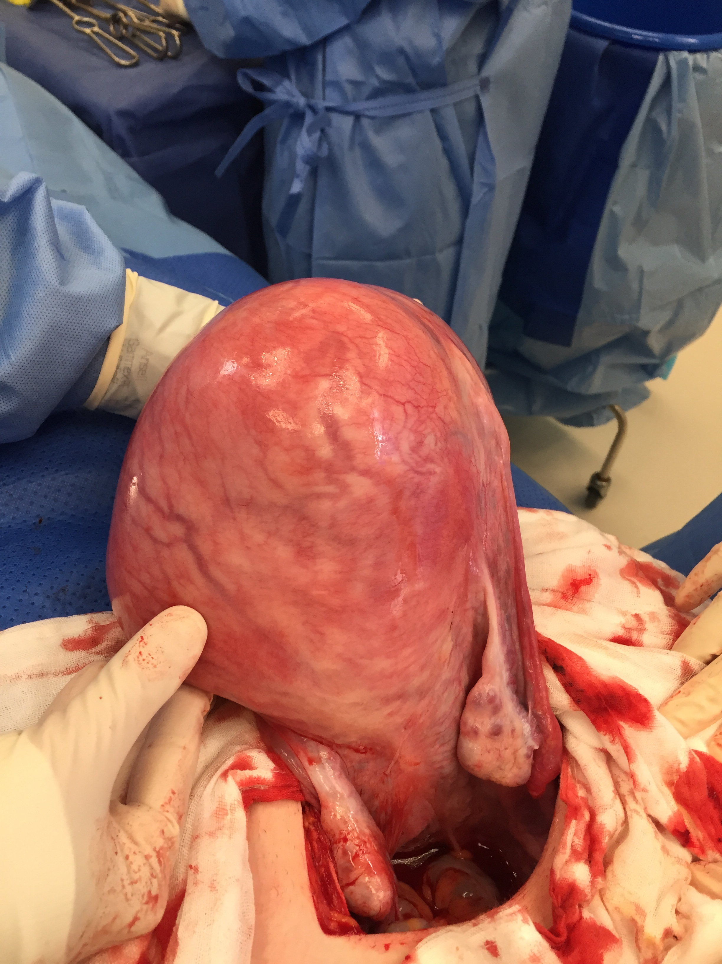

Slide 7
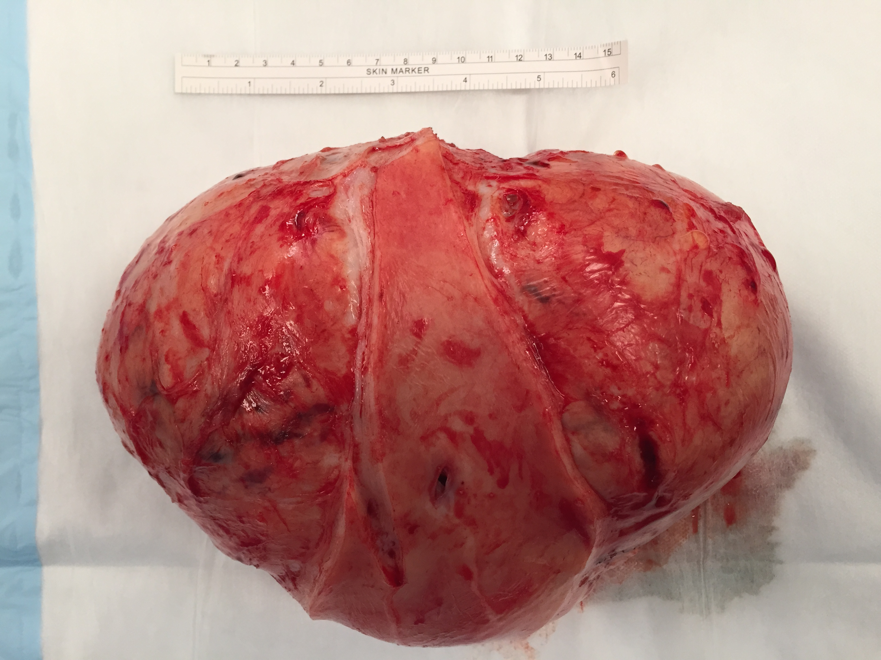

Slide 8
